Slide 1
Gate-level minimization is the design task of finding an optimal gate-level implementation of Boolean functions describing a digital circuit.

Slide 2
Boolean function
  Sum of minterms
  Sum of products (or product of sum) in the simplest form
  A minimum number of terms
  A minimum number of literals
  The simplified expression may not be unique

Slide 3
Logic minimization
  Algebraic approaches: lack specific rules
  The Karnaugh map (or K-map)
    a simple straight forward procedure
    a pictorial form of a truth table
    applicable if the # of variables < 7

Slide 4
  Karnaugh map (or K-map)
A diagram made up of squares. Each square represents one minterm

Slide 5
  Two-variable K-map
  A truth table in square diagram
  F = xy’ + x’y + xy

Slide 6
  Two-variable K-map
  A truth table in square diagram
  F = xy’ + x’y + xy
x | y | F
0 | 0 | 0
0 | 1 | 1
1 | 0 | 1
1 | 1 | 1

Slide 7
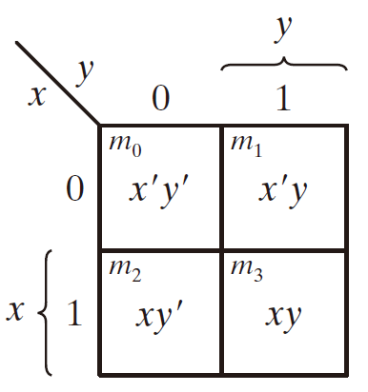
  Two-variable K-map
  A truth table in square diagram
  F = xy’ + x’y + xy
x | y | F
0 | 0 | 0
0 | 1 | 1
1 | 0 | 1
1 | 1 | 1

Slide 8
  Two-variable K-map
  A truth table in square diagram
  4 minterms
  x' = row 0
  x = row 1
  y' = column 0
  y = column 1
  F = xy’ + x’y + xy
x | y | F
0 | 0 | 0
0 | 1 | 1
1 | 0 | 1
1 | 1 | 1

Slide 9
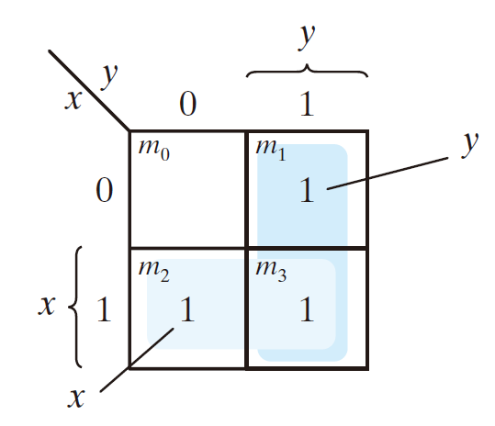
  Two-variable K-map
  A truth table in square diagram
  4 minterms
  x' = row 0
  x = row 1
  y' = column 0
  y = column 1
  F = xy’ + x’y + xy
x | y | F
0 | 0 | 0
0 | 1 | 1
1 | 0 | 1
1 | 1 | 1

Slide 10
  Two-variable K-map
  A truth table in square diagram
  F = xy’ + x’y + xy
x | y | F
0 | 0 | 0
0 | 1 | 1
1 | 0 | 1
1 | 1 | 1

Slide 11
  Two-variable K-map
  A truth table in square diagram
  xy’ + xy
  F = xy’ + x’y + xy
x | y | F
0 | 0 | 0
0 | 1 | 1
1 | 0 | 1
1 | 1 | 1

Slide 12
  Two-variable K-map
  A truth table in square diagram
  xy’ + xy
  = x(y’ + y)
  = x
  F = xy’ + x’y + xy
x | y | F
0 | 0 | 0
0 | 1 | 1
1 | 0 | 1
1 | 1 | 1

Slide 13
  Two-variable K-map
  A truth table in square diagram
  F = xy’ + x’y + xy
x | y | F
0 | 0 | 0
0 | 1 | 1
1 | 0 | 1
1 | 1 | 1

Slide 14
  Two-variable K-map
  A truth table in square diagram
  x’y + xy
  F = xy’ + x’y + xy
x | y | F
0 | 0 | 0
0 | 1 | 1
1 | 0 | 1
1 | 1 | 1

Slide 15
  Two-variable K-map
  A truth table in square diagram
  x’y + xy
  = (x‘ + x)y
  = y
  F = xy’ + x’y + xy
x | y | F
0 | 0 | 0
0 | 1 | 1
1 | 0 | 1
1 | 1 | 1

Slide 16
  Two-variable K-map
  A truth table in square diagram
  F = xy’ + x’y + xy
x | y | F
0 | 0 | 0
0 | 1 | 1
1 | 0 | 1
1 | 1 | 1

Slide 17
  Two-variable K-map
  A truth table in square diagram
  F = xy’ + x’y + xy = x + y
x | y | F
0 | 0 | 0
0 | 1 | 1
1 | 0 | 1
1 | 1 | 1

Slide 18
  Two-variable K-map
  A truth table in square diagram
  F = xy’ + x’y + xy

Slide 19
  Two-variable K-map
  A truth table in square diagram
  F = xy’ + x’y + xy = xy’ + x’y + xy + xy

Slide 20
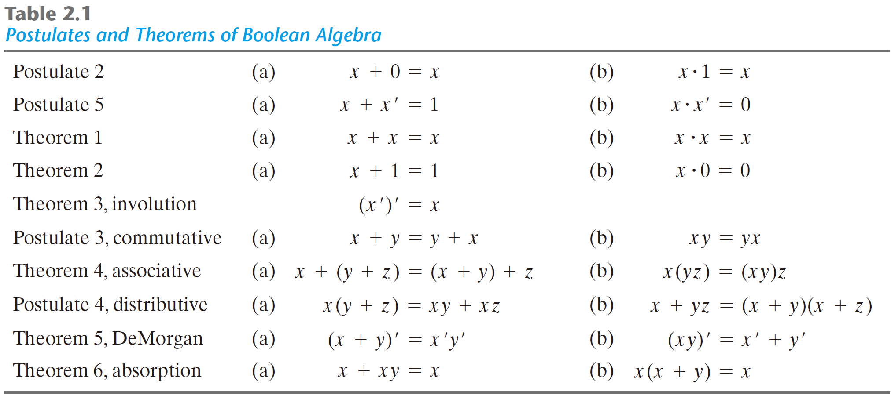

Slide 21
  Two-variable K-map
  A truth table in square diagram
  F = xy’ + x’y + xy = xy’ + x’y + xy + xy

Slide 22
  Two-variable K-map
  A truth table in square diagram
  F = xy’ + x’y + xy = xy’ + x’y + xy + xy = x + y

Slide 23
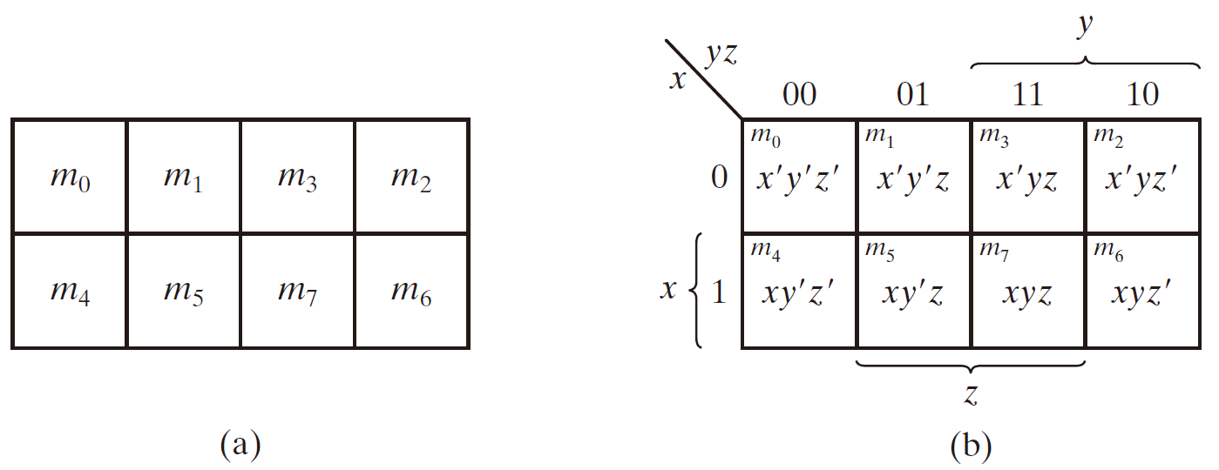
  Three-variable K-map
  8 minterms
  Any two adjacent squares in the map differ by only on variable, primed in one square and unprimed in the other

Slide 24
  Three-variable K-map
Two adjacent minterms can be simplified

Slide 25
  Three-variable K-map
Two adjacent minterms can be simplified
    m₅ + m₇
    = xy’z + xyz
    = xz (y’ + y)
    = xz

Slide 26
  Three-variable K-map
Example 3-1: F(x, y, z) = ∑(2, 3, 4, 5)

Slide 27
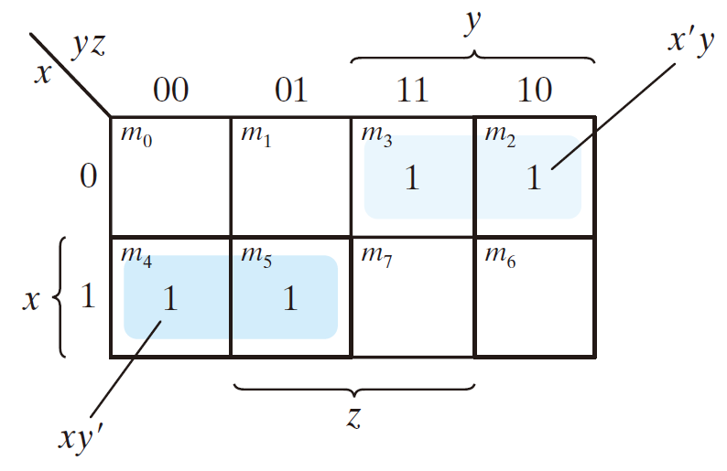
  Three-variable K-map
Example 3-1: F(x, y, z) = ∑(2, 3, 4, 5)

Slide 28
  Three-variable K-map
Example 3-1: F(x, y, z) = ∑(2, 3, 4, 5)
x’yz + x’yz’

Slide 29
  Three-variable K-map
Example 3-1: F(x, y, z) = ∑(2, 3, 4, 5)
x’yz + x’yz’
= x’y

Slide 30
  Three-variable K-map
Example 3-1: F(x, y, z) = ∑(2, 3, 4, 5)
x’yz + x’yz’
= x’y
xy’z’ + xy’z

Slide 31
  Three-variable K-map
Example 3-1: F(x, y, z) = ∑(2, 3, 4, 5)
x’yz + x’yz’
= x’y
xy’z’ + xy’z
= xy’

Slide 32
  Three-variable K-map
  Example 3-1: F(x, y, z) = ∑(2, 3, 4, 5) = x’y + xy’

Slide 33
  Three-variable K-map
  m₀ and m₂ are adjacent

Slide 34
  Three-variable K-map
  m₀ and m₂ are adjacent
  M₀ + m₂
  = x'y'z' + x'yz'
  = x'z' (y'+y)
  = x'z'

Slide 35
  Three-variable K-map
  m₄ and m₆ are adjacent

Slide 36
  Three-variable K-map
  m₄ and m₆ are adjacent
  M₄ + m₆
  = xy'z' + xyz'
  = xz' (y'+y)
  = xz'

Slide 37
  Three-variable K-map
Example 3-2: F(x, y, z) = Σ(3, 4, 6, 7)

Slide 38
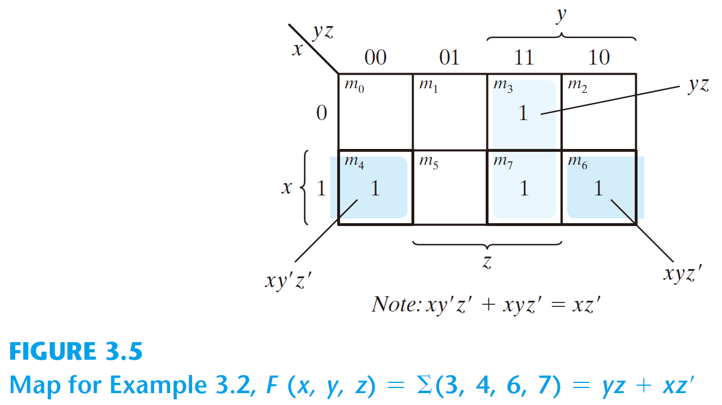
  Three-variable K-map
Example 3-2: F(x, y, z) = Σ(3, 4, 6, 7)

Slide 39
  Three-variable K-map
Example 3-2: F(x, y, z) = Σ(3, 4, 6, 7)
x’yz + xyz

Slide 40
  Three-variable K-map
Example 3-2: F(x, y, z) = Σ(3, 4, 6, 7)
x’yz + xyz
= yz

Slide 41
  Three-variable K-map
Example 3-2: F(x, y, z) = Σ(3, 4, 6, 7)
x’yz + xyz
= yz
xy’z’ + xyz’

Slide 42
  Three-variable K-map
Example 3-2: F(x, y, z) = Σ(3, 4, 6, 7)
x’yz + xyz
= yz
xy’z’ + xyz’
= xz’

Slide 43
  Three-variable K-map
Example 3-2: F(x, y, z) = Σ(3, 4, 6, 7) = xz’ + yz
x’yz + xyz
= yz
xy’z’ + xyz’
= xz’

Slide 44
  Three-variable K-map
Four adjacent squares

Slide 45
  Three-variable K-map
Four adjacent squares
  m₁ + m₃ + m₅ + m₇
  = x'y'z + x'yz + xy'z + xyz
  = x'z(y' + y) + xz(y' + y)
  = x'z + xz
  = z

Slide 46
  Three-variable K-map
Four adjacent squares
  m₁ + m₃ + m₅ + m₇
  = x'y'z + x'yz + xy'z + xyz
  = x'z(y' + y) + xz(y' + y)
  = x'z + xz
  = z

Slide 47
  Three-variable K-map
Four adjacent squares
  m₁ + m₃ + m₅ + m₇
  = x'y'z + x'yz + xy'z + xyz
  = x'z(y' + y) + xz(y' + y)
  = x'z + xz
  = z

Slide 48
  Three-variable K-map
Four adjacent squares
  m₁ + m₃ + m₅ + m₇
  = x'y'z + x'yz + xy'z + xyz
  = x'z(y' + y) + xz(y' + y)
  = x'z + xz
  = z

Slide 49
  Three-variable K-map
Four adjacent squares
  m₀ + m₂ + m₄ + m₆
  = x'y'z' + x'yz' + xy'z' + xyz'
  = x'z'(y' + y) + xz'(y' + y)
  = x'z' + xz‘
  = z'

Slide 50
  Three-variable K-map
  2, 4, and 8 squares

Slide 51
  Three-variable K-map
  x‘y’z‘ + x’yz‘ + xy’z‘ + xyz’ + x'y'z + x'yz + xy'z + xyz
x‘z‘
+
xz‘
+
x’z
+
xz
z‘
+
z
1

Slide 52
  Three-variable K-map
Example 3-3: F(x, y, z) = Σ(0, 2, 4, 5, 6)

Slide 53
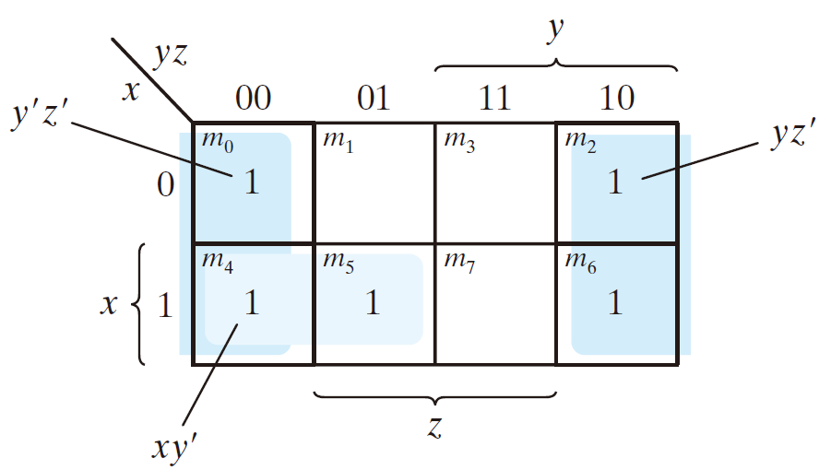
  Three-variable K-map
Example 3-3: F(x, y, z) = Σ(0, 2, 4, 5, 6)

Slide 54
  Three-variable K-map
Example 3-3: F(x, y, z) = Σ(0, 2, 4, 5, 6) =

Slide 55
  Three-variable K-map
Example 3-3: F(x, y, z) = Σ(0, 2, 4, 5, 6) = z’

Slide 56
  Three-variable K-map
Example 3-3: F(x, y, z) = Σ(0, 2, 4, 5, 6) = z’

Slide 57
  Three-variable K-map
Example 3-3: F(x, y, z) = Σ(0, 2, 4, 5, 6) = z’ + xy

Slide 58
  All the minterms are covered
  Minimize the number of terms

Slide 59
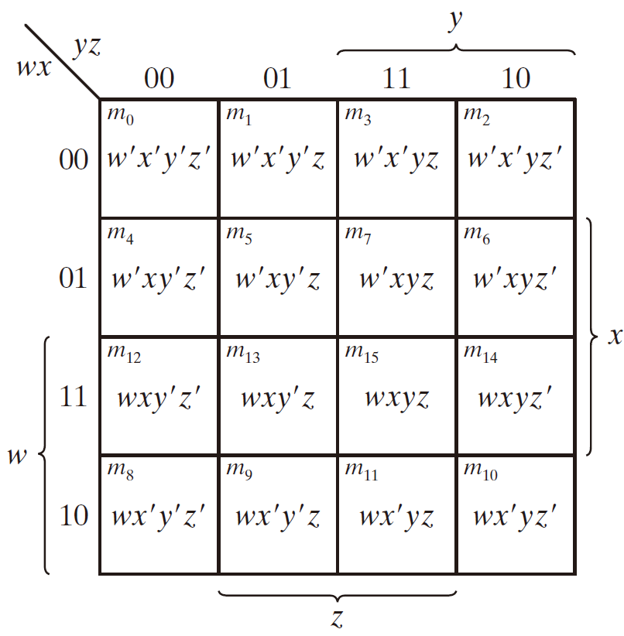
  Four-variable K-map
  16 minterms

Slide 60
  Four-variable K-map
  combinations of 2, 4, 8, and 16 adjacent squares

Slide 61
  Four-variable K-map
  F(w, x, y, z) = ∑(0, 1, 2, 4, 5, 6, 8, 9, 12, 13, 14)

Slide 62
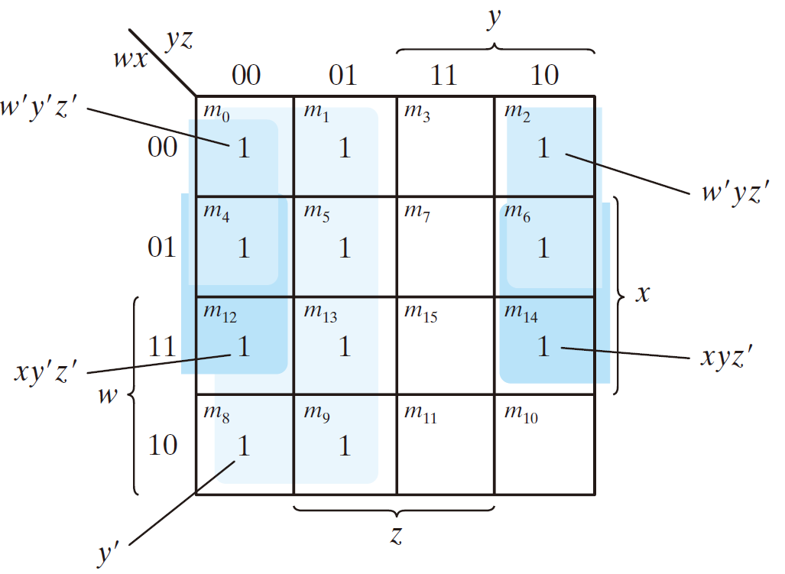
  Four-variable K-map
  F(w, x, y, z) = ∑(0, 1, 2, 4, 5, 6, 8, 9, 12, 13, 14)

Slide 63
  Four-variable K-map
  F(w, x, y, z) = ∑(0, 1, 2, 4, 5, 6, 8, 9, 12, 13, 14)

Slide 64
  Four-variable K-map
  F(w, x, y, z) = ∑(0, 1, 2, 4, 5, 6, 8, 9, 12, 13, 14)
w’x’y’z’ + w’x’y’z
w’xy’z’ + w’xy’z
wxy’z’ + wxy’z
wx’y’z’ + wx’y’z

Slide 65
  Four-variable K-map
  F(w, x, y, z) = ∑(0, 1, 2, 4, 5, 6, 8, 9, 12, 13, 14)
w’x’y’z’ + w’x’y’z = w’x’y’
w’xy’z’ + w’xy’z = w’xy’
wxy’z’ + wxy’z = wxy’
wx’y’z’ + wx’y’z = wx’y’

Slide 66
  Four-variable K-map
  F(w, x, y, z) = ∑(0, 1, 2, 4, 5, 6, 8, 9, 12, 13, 14)
w’x’y’
w’xy’
wxy’
wx’y’

Slide 67
  Four-variable K-map
  F(w, x, y, z) = ∑(0, 1, 2, 4, 5, 6, 8, 9, 12, 13, 14)
w’x’y’ + w’xy’
wxy’ + wx’y’

Slide 68
  Four-variable K-map
  F(w, x, y, z) = ∑(0, 1, 2, 4, 5, 6, 8, 9, 12, 13, 14)
w’x’y’ + w’xy’ = w’y’
wxy’ + wx’y’ = wy’

Slide 69
  Four-variable K-map
  F(w, x, y, z) = ∑(0, 1, 2, 4, 5, 6, 8, 9, 12, 13, 14)
w’y’
wy’

Slide 70
  Four-variable K-map
  F(w, x, y, z) = ∑(0, 1, 2, 4, 5, 6, 8, 9, 12, 13, 14)
w’y’ + wy’

Slide 71
  Four-variable K-map
  F(w, x, y, z) = ∑(0, 1, 2, 4, 5, 6, 8, 9, 12, 13, 14)
w’y’ + wy’ = y’

Slide 72
  Four-variable K-map
  F(w, x, y, z) = ∑(0, 1, 2, 4, 5, 6, 8, 9, 12, 13, 14)
y’

Slide 73
  Four-variable K-map
  F(w, x, y, z) = ∑(0, 1, 2, 4, 5, 6, 8, 9, 12, 13, 14)

Slide 74
  Four-variable K-map
  F(w, x, y, z) = ∑(0, 1, 2, 4, 5, 6, 8, 9, 12, 13, 14)
w’x’y’z’ + w’x’yz’
w’xy’z’ + w’xyz’

Slide 75
  Four-variable K-map
  F(w, x, y, z) = ∑(0, 1, 2, 4, 5, 6, 8, 9, 12, 13, 14)
w’x’y’z’ + w’x’yz’ = w’x’z’
w’xy’z’ + w’xyz’ = w’xz’

Slide 76
  Four-variable K-map
  F(w, x, y, z) = ∑(0, 1, 2, 4, 5, 6, 8, 9, 12, 13, 14)
w’x’z’
w’xz’

Slide 77
  Four-variable K-map
  F(w, x, y, z) = ∑(0, 1, 2, 4, 5, 6, 8, 9, 12, 13, 14)
w’x’z’ + w’xz’ = w’z’

Slide 78
  Four-variable K-map
  F(w, x, y, z) = ∑(0, 1, 2, 4, 5, 6, 8, 9, 12, 13, 14)

Slide 79
  Four-variable K-map
  F(w, x, y, z) = ∑(0, 1, 2, 4, 5, 6, 8, 9, 12, 13, 14)
xz’

Slide 80
  Four-variable K-map
  F(w, x, y, z) = ∑(0, 1, 2, 4, 5, 6, 8, 9, 12, 13, 14)

Slide 81
  Four-variable K-map
  F(w, x, y, z) = ∑(0, 1, 2, 4, 5, 6, 8, 9, 12, 13, 14)
y’

Slide 82
  Four-variable K-map
  F(w, x, y, z) = ∑(0, 1, 2, 4, 5, 6, 8, 9, 12, 13, 14)
w’z’
y’

Slide 83
  Four-variable K-map
  F(w, x, y, z) = ∑(0, 1, 2, 4, 5, 6, 8, 9, 12, 13, 14)
w’z’
y’
xz’

Slide 84
  Four-variable K-map
  F(w, x, y, z) = y’ + xz’ + w’z’
w’z’
y’
xz’

Slide 85
  Four-variable K-map
F = A′B′C′ + B′CD′ + A′BCD′ + AB′C′

Slide 86
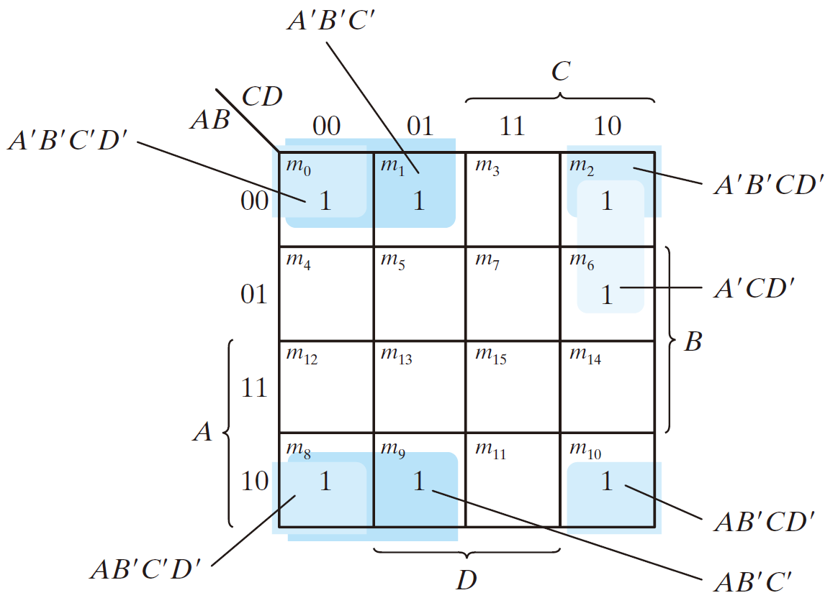
  Four-variable K-map
F = A′B′C′ + B′CD′ + A′BCD′ + AB′C′

Slide 87
  Four-variable K-map
F = A′B′C′ + B′CD′ + A′BCD′ + AB′C′
A’B’C’

Slide 88
  Four-variable K-map
F = A′B′C′ + B′CD′ + A′BCD′ + AB′C′
A’B’C’
= A’B’C’(D + D’)
= A’B’C’D + A’B’C’D’

Slide 89
  Four-variable K-map
F = A′B′C′ + B′CD′ + A′BCD′ + AB′C′
A’B’C’
= A’B’C’(D + D’)
= A’B’C’D + A’B’C’D’

Slide 90
  Four-variable K-map
F = A′B′C′ + B′CD′ + A′BCD′ + AB′C′
A’B’C’
= A’B’C’(D + D’)
= A’B’C’D + A’B’C’D’
A’B’C’

Slide 91
  Four-variable K-map
F = A′B′C′ + B′CD′ + A′BCD′ + AB′C′
A’B’C’
= A’B’C’(D + D’)
= A’B’C’D + A’B’C’D’
A’B’C’
0 0 0 X

Slide 92
  Four-variable K-map
F = A′B′C′ + B′CD′ + A′BCD′ + AB′C′
A’B’C’
= A’B’C’(D + D’)
= A’B’C’D + A’B’C’D’
A’B’C’
0 0 0 X
0 0 0 0
0 0 0 1

Slide 93
  Four-variable K-map
F = A′B′C′ + B′CD′ + A′BCD′ + AB′C′
B’CD’

Slide 94
  Four-variable K-map
F = A′B′C′ + B′CD′ + A′BCD′ + AB′C′
B’CD’
X 0 1 0

Slide 95
  Four-variable K-map
F = A′B′C′ + B′CD′ + A′BCD′ + AB′C′
B’CD’
X 0 1 0
1 0 1 0
0 0 1 0

Slide 96
  Four-variable K-map
F = A′B′C′ + B′CD′ + A′BCD′ + AB′C′
B’CD’
X 0 1 0
1 0 1 0
0 0 1 0

Slide 97
  Four-variable K-map
F = A′B′C′ + B′CD′ + A′BCD′ + AB′C′
A’BCD’

Slide 98
  Four-variable K-map
F = A′B′C′ + B′CD′ + A′BCD′ + AB′C′
A’BCD’
0 1 1 0

Slide 99
  Four-variable K-map
F = A′B′C′ + B′CD′ + A′BCD′ + AB′C′
A’BCD’
0 1 1 0

Slide 100
  Four-variable K-map
F = A′B′C′ + B′CD′ + A′BCD′ + AB′C′
AB’C’

Slide 101
  Four-variable K-map
F = A′B′C′ + B′CD′ + A′BCD′ + AB′C′
AB’C’
1 0 0 X

Slide 102
  Four-variable K-map
F = A′B′C′ + B′CD′ + A′BCD′ + AB′C′
AB’C’
1 0 0 X
1 0 0 0
1 0 0 1

Slide 103
  Four-variable K-map
F = A′B′C′ + B′CD′ + A′BCD′ + AB′C′
AB’C’
1 0 0 X
1 0 0 0
1 0 0 1

Slide 104
  Four-variable K-map
F = A′B′C′ + B′CD′ + A′BCD′ + AB′C′

Slide 105
  Four-variable K-map
F = A′B′C′ + B′CD′ + A′BCD′ + AB′C′

Slide 106
  Four-variable K-map
F = A′B′C′ + B′CD′ + A′BCD′ + AB′C′
B’C

Slide 107
  Four-variable K-map
F = A′B′C′ + B′CD′ + A′BCD′ + AB′C′

Slide 108
  Four-variable K-map
F = A′B′C′ + B′CD′ + A′BCD′ + AB′C′
B’D’

Slide 109
  Four-variable K-map
F = A′B′C′ + B′CD′ + A′BCD′ + AB′C′
A’CD’

Slide 110
  Four-variable K-map
F = A′B′C′ + B′CD′ + A′BCD′ + AB′C′
= B’C + B’D’ + A’CD’

Slide 111
Prime Implicants
  Implicant: a product term obtained by combining adjacent squares
  Prime implicant: a product term obtained by combining the maximum possible number of adjacent squares (combining all possible maximum numbers of squares)
  Essential Prime implicant: a minterm is covered by only one prime implicant

Slide 113
CD
 | 00 | 01 | 11 | 10
00 | 1 |  | 1 | 1
01 |  | 1 | 1
11 |  | 1 | 1
10 | 1 | 1 | 1 | 1
AB

Slide 114
CD
 | 00 | 01 | 11 | 10
00 | 1 |  | 1 | 1
01 |  | 1 | 1
11 |  | 1 | 1
10 | 1 | 1 | 1 | 1
AB

Slide 115
CD
 | 00 | 01 | 11 | 10
00 | 1 |  | 1 | 1
01 |  | 1 | 1
11 |  | 1 | 1
10 | 1 | 1 | 1 | 1
AB
 | A’B’C

Slide 116
Implicant
CD
 | 00 | 01 | 11 | 10
00 | 1 |  | 1 | 1
01 |  | 1 | 1
11 |  | 1 | 1
10 | 1 | 1 | 1 | 1
AB
 | A’B’C

Slide 117
CD
 | 00 | 01 | 11 | 10
00 | 1 |  | 1 | 1
01 |  | 1 | 1
11 |  | 1 | 1
10 | 1 | 1 | 1 | 1
AB

Slide 118
CD
 | 00 | 01 | 11 | 10
00 | 1 |  | 1 | 1
01 |  | 1 | 1
11 |  | 1 | 1
10 | 1 | 1 | 1 | 1
AB
 | BC’D

Slide 119
Implicant
CD
 | 00 | 01 | 11 | 10
00 | 1 |  | 1 | 1
01 |  | 1 | 1
11 |  | 1 | 1
10 | 1 | 1 | 1 | 1
AB
 | BC’D

Slide 120
CD
 | 00 | 01 | 11 | 10
00 | 1 |  | 1 | 1
01 |  | 1 | 1
11 |  | 1 | 1
10 | 1 | 1 | 1 | 1
AB
1 | BD

Slide 121
Prime implicant
CD
 | 00 | 01 | 11 | 10
00 | 1 |  | 1 | 1
01 |  | 1 | 1
11 |  | 1 | 1
10 | 1 | 1 | 1 | 1
AB
1 | BD

Slide 122
Prime implicant
CD
 | 00 | 01 | 11 | 10
00 | 1 |  | 1 | 1
01 |  | 1 | 1
11 |  | 1 | 1
10 | 1 | 1 | 1 | 1
AB
1 | BD
2 | AD

Slide 123
Prime implicant
CD
 | 00 | 01 | 11 | 10
00 | 1 |  | 1 | 1
01 |  | 1 | 1
11 |  | 1 | 1
10 | 1 | 1 | 1 | 1
AB
1 | BD
2 | AD
3 | AB’

Slide 124
Prime implicant
CD
 | 00 | 01 | 11 | 10
00 | 1 |  | 1 | 1
01 |  | 1 | 1
11 |  | 1 | 1
10 | 1 | 1 | 1 | 1
AB
1 | BD
2 | AD
3 | AB’
4 | CD

Slide 125
Prime implicant
CD
 | 00 | 01 | 11 | 10
00 | 1 |  | 1 | 1
01 |  | 1 | 1
11 |  | 1 | 1
10 | 1 | 1 | 1 | 1
AB
1 | BD
2 | AD
3 | AB’
4 | CD
5 | B’D’

Slide 126
Prime implicant
CD
 | 00 | 01 | 11 | 10
00 | 1 |  | 1 | 1
01 |  | 1 | 1
11 |  | 1 | 1
10 | 1 | 1 | 1 | 1
AB
1 | BD
2 | AD
3 | AB’
4 | CD
5 | B’D’
6 | B’C

Slide 127
Prime implicant
CD
 | 00 | 01 | 11 | 10
00 | 1 |  | 1 | 1
01 |  | 1 | 1
11 |  | 1 | 1
10 | 1 | 1 | 1 | 1
AB
1 | BD
2 | AD
3 | AB’
4 | CD
5 | B’D’
6 | B’C

Slide 128
Essitial prime implicant ?
CD
 | 00 | 01 | 11 | 10
00 | 1 |  | 1 | 1
01 |  | 1 | 1
11 |  | 1 | 1
10 | 1 | 1 | 1 | 1
AB
1 | BD
2 | AD
3 | AB’
4 | CD
5 | B’D’
6 | B’C

Slide 129
Essitial prime implicant ?
CD
 | 00 | 01 | 11 | 10
00 | 1 |  | 1 | 1
01 |  | 1 | 1
11 |  | 1 | 1
10 | 1 | 1 | 1 | 1
AB
1 | BD
2 | AD
3 | AB’
4 | CD
5 | B’D’
6 | B’C

Slide 130
Essitial prime implicant ?
CD
 | 00 | 01 | 11 | 10
00 | 1 |  | 1 | 1
01 |  | 1 | 1
11 |  | 1 | 1
10 | 1 | 1 | 1 | 1
AB
1 | BD
2 | AD
3 | AB’
4 | CD
5 | B’D’
6 | B’C

Slide 131
Essitial prime implicant ?
CD
 | 00 | 01 | 11 | 10
00 | 1 |  | 1 | 1
01 |  | 1 | 1
11 |  | 1 | 1
10 | 1 | 1 | 1 | 1
AB
1 | BD
2 | AD
3 | AB’
4 | CD
5 | B’D’
6 | B’C

Slide 132
Essitial prime implicant ?
CD
 | 00 | 01 | 11 | 10
00 | 1 |  | 1 | 1
01 |  | 1 | 1
11 |  | 1 | 1
10 | 1 | 1 | 1 | 1
AB
AB
1 | BD
2 | AD
3 | AB’
4 | CD
5 | B’D’
6 | B’C

Slide 133
Essitial prime implicant ?
CD
 | 00 | 01 | 11 | 10
00 | 1 |  | 1 | 1
01 |  | 1 | 1
11 |  | 1 | 1
10 | 1 | 1 | 1 | 1
AB
1 | BD
2 | AD
3 | AB’
4 | CD
5 | B’D’
6 | B’C
X

Slide 134
Essitial prime implicant ?
CD
 | 00 | 01 | 11 | 10
00 | 1 |  | 1 | 1
01 |  | 1 | 1
11 |  | 1 | 1
10 | 1 | 1 | 1 | 1
AB
1 | BD

Slide 135
Essitial prime implicant ?
CD
 | 00 | 01 | 11 | 10
00 | 1 |  | 1 | 1
01 |  | 1 | 1
11 |  | 1 | 1
10 | 1 | 1 | 1 | 1
AB
1 | BD

Slide 136
Essitial prime implicant ?
CD
 | 00 | 01 | 11 | 10
00 | 1 |  | 1 | 1
01 |  | 1 | 1
11 |  | 1 | 1
10 | 1 | 1 | 1 | 1
AB
1 | BD

Slide 137
Essitial prime implicant ?
CD
 | 00 | 01 | 11 | 10
00 | 1 |  | 1 | 1
01 |  | 1 | 1
11 |  | 1 | 1
10 | 1 | 1 | 1 | 1
AB
1 | BD

Slide 138
Essitial prime implicant ?
CD
 | 00 | 01 | 11 | 10
00 | 1 |  | 1 | 1
01 |  | 1 | 1
11 |  | 1 | 1
10 | 1 | 1 | 1 | 1
AB
1 | BD

Slide 139
Essitial prime implicant ?
CD
 | 00 | 01 | 11 | 10
00 | 1 |  | 1 | 1
01 |  | 1 | 1
11 |  | 1 | 1
10 | 1 | 1 | 1 | 1
AB
1 | BD

Slide 140
Essitial prime implicant ?
CD
 | 00 | 01 | 11 | 10
00 | 1 |  | 1 | 1
01 |  | 1 | 1
11 |  | 1 | 1
10 | 1 | 1 | 1 | 1
√
AB
1 | BD

Slide 141
Essitial prime implicant ?
CD
 | 00 | 01 | 11 | 10
00 | 1 |  | 1 | 1
01 |  | 1 | 1
11 |  | 1 | 1
10 | 1 | 1 | 1 | 1
AB
4 | CD

Slide 142
Essitial prime implicant ?
CD
 | 00 | 01 | 11 | 10
00 | 1 |  | 1 | 1
01 |  | 1 | 1
11 |  | 1 | 1
10 | 1 | 1 | 1 | 1
AB
4 | CD

Slide 143
Essitial prime implicant ?
CD
 | 00 | 01 | 11 | 10
00 | 1 |  | 1 | 1
01 |  | 1 | 1
11 |  | 1 | 1
10 | 1 | 1 | 1 | 1
AB
4 | CD

Slide 144
Essitial prime implicant ?
CD
 | 00 | 01 | 11 | 10
00 | 1 |  | 1 | 1
01 |  | 1 | 1
11 |  | 1 | 1
10 | 1 | 1 | 1 | 1
AB
4 | CD

Slide 145
Essitial prime implicant ?
CD
 | 00 | 01 | 11 | 10
00 | 1 |  | 1 | 1
01 |  | 1 | 1
11 |  | 1 | 1
10 | 1 | 1 | 1 | 1
AB
AB
4 | CD

Slide 146
Essitial prime implicant ?
CD
 | 00 | 01 | 11 | 10
00 | 1 |  | 1 | 1
01 |  | 1 | 1
11 |  | 1 | 1
10 | 1 | 1 | 1 | 1
AB
AB
4 | CD
X

Slide 147
Essitial prime implicant ?
CD
 | 00 | 01 | 11 | 10
00 | 1 |  | 1 | 1
01 |  | 1 | 1
11 |  | 1 | 1
10 | 1 | 1 | 1 | 1
AB
5 | B’D’

Slide 148
Essitial prime implicant ?
CD
 | 00 | 01 | 11 | 10
00 | 1 |  | 1 | 1
01 |  | 1 | 1
11 |  | 1 | 1
10 | 1 | 1 | 1 | 1
AB
5 | B’D’

Slide 149
Essitial prime implicant ?
CD
 | 00 | 01 | 11 | 10
00 | 1 |  | 1 | 1
01 |  | 1 | 1
11 |  | 1 | 1
10 | 1 | 1 | 1 | 1
AB
5 | B’D’

Slide 150
Essitial prime implicant ?
CD
 | 00 | 01 | 11 | 10
00 | 1 |  | 1 | 1
01 |  | 1 | 1
11 |  | 1 | 1
10 | 1 | 1 | 1 | 1
AB
5 | B’D’

Slide 151
Essitial prime implicant ?
CD
 | 00 | 01 | 11 | 10
00 | 1 |  | 1 | 1
01 |  | 1 | 1
11 |  | 1 | 1
10 | 1 | 1 | 1 | 1
AB
5 | B’D’

Slide 152
Essitial prime implicant ?
CD
 | 00 | 01 | 11 | 10
00 | 1 |  | 1 | 1
01 |  | 1 | 1
11 |  | 1 | 1
10 | 1 | 1 | 1 | 1
AB
5 | B’D’

Slide 153
Essitial prime implicant ?
CD
 | 00 | 01 | 11 | 10
00 | 1 |  | 1 | 1
01 |  | 1 | 1
11 |  | 1 | 1
10 | 1 | 1 | 1 | 1
AB
5 | B’D’
√

Slide 154
Prime implicant
CD
 | 00 | 01 | 11 | 10
00 | 1 |  | 1 | 1
01 |  | 1 | 1
11 |  | 1 | 1
10 | 1 | 1 | 1 | 1
AB
1 | BD
2 | AD
3 | AB’
4 | CD
5 | B’D’
6 | B’C

Slide 155
Prime implicant
CD
 | 00 | 01 | 11 | 10
00 | 1 |  | 1 | 1
01 |  | 1 | 1
11 |  | 1 | 1
10 | 1 | 1 | 1 | 1
 | 00 | 01 | 11 | 10
00 | 1 |  | 1 | 1
01 |  | 1 | 1
11 |  | 1 | 1
10 | 1 | 1 | 1 | 1
AB
AB
1 | BD | Essential
2 | AD
3 | AB’
4 | CD
5 | B’D’ | Essential
6 | B’C

Slide 156
  The essential P.I. must be included

Slide 157
F = BD + B’D
CD
 | 00 | 01 | 11 | 10
00 | 1 |  | 1 | 1
01 |  | 1 | 1
11 |  | 1 | 1
10 | 1 | 1 | 1 | 1
 | 00 | 01 | 11 | 10
00 | 1 |  | 1 | 1
01 |  | 1 | 1
11 |  | 1 | 1
10 | 1 | 1 | 1 | 1
AB
AB
1 | BD | Essential
2 | AD
3 | AB’
4 | CD
5 | B’D’ | Essential
6 | B’C

Slide 158
F = BD + B’D
CD
 | 00 | 01 | 11 | 10
00 | 1 |  | 1 | 1
01 |  | 1 | 1
11 |  | 1 | 1
10 | 1 | 1 | 1 | 1
 | 00 | 01 | 11 | 10
00 | 1 |  | 1 | 1
01 |  | 1 | 1
11 |  | 1 | 1
10 | 1 | 1 | 1 | 1
AB
1 | BD | Essential
2 | AD
3 | AB’
4 | CD
5 | B’D’ | Essential
6 | B’C

Slide 159
F = BD + B‘D
CD
 | 00 | 01 | 11 | 10
00 | 1 |  | 1 | 1
01 |  | 1 | 1
11 |  | 1 | 1
10 | 1 | 1 | 1 | 1
 | 00 | 01 | 11 | 10
00 | 1 |  | 1 | 1
01 |  | 1 | 1
11 |  | 1 | 1
10 | 1 | 1 | 1 | 1
AB
AB
1 | BD | Essential
2 | AD
3 | AB’
4 | CD
5 | B’D’ | Essential
6 | B’C

Slide 160
F = BD + B‘D
CD
 | 00 | 01 | 11 | 10
00 | 1 |  | 1 | 1
01 |  | 1 | 1
11 |  | 1 | 1
10 | 1 | 1 | 1 | 1
 | 00 | 01 | 11 | 10
00 | 1 |  | 1 | 1
01 |  | 1 | 1
11 |  | 1 | 1
10 | 1 | 1 | 1 | 1
AB
AB
1 | BD | Essential
2 | AD
3 | AB’
4 | CD
5 | B’D’ | Essential
6 | B’C

Slide 161
F = BD + B‘D + AD
CD
 | 00 | 01 | 11 | 10
00 | 1 |  | 1 | 1
01 |  | 1 | 1
11 |  | 1 | 1
10 | 1 | 1 | 1 | 1
 | 00 | 01 | 11 | 10
00 | 1 |  | 1 | 1
01 |  | 1 | 1
11 |  | 1 | 1
10 | 1 | 1 | 1 | 1
AB
AB
1 | BD | Essential
2 | AD
3 | AB’
4 | CD
5 | B’D’ | Essential
6 | B’C

Slide 162
F = BD + B‘D + AD
CD
 | 00 | 01 | 11 | 10
00 | 1 |  | 1 | 1
01 |  | 1 | 1
11 |  | 1 | 1
10 | 1 | 1 | 1 | 1
 | 00 | 01 | 11 | 10
00 | 1 |  | 1 | 1
01 |  | 1 | 1
11 |  | 1 | 1
10 | 1 | 1 | 1 | 1
AB
AB
1 | BD | Essential
2 | AD
3 | AB’
4 | CD
5 | B’D’ | Essential
6 | B’C

Slide 163
F = BD + B‘D + AD
CD
 | 00 | 01 | 11 | 10
00 | 1 |  | 1 | 1
01 |  | 1 | 1
11 |  | 1 | 1
10 | 1 | 1 | 1 | 1
 | 00 | 01 | 11 | 10
00 | 1 |  | 1 | 1
01 |  | 1 | 1
11 |  | 1 | 1
10 | 1 | 1 | 1 | 1
AB
AB
1 | BD | Essential
2 | AD
3 | AB’
4 | CD
5 | B’D’ | Essential
6 | B’C

Slide 164
F = BD + B‘D + AD + B’C
CD
 | 00 | 01 | 11 | 10
00 | 1 |  | 1 | 1
01 |  | 1 | 1
11 |  | 1 | 1
10 | 1 | 1 | 1 | 1
 | 00 | 01 | 11 | 10
00 | 1 |  | 1 | 1
01 |  | 1 | 1
11 |  | 1 | 1
10 | 1 | 1 | 1 | 1
AB
AB
1 | BD | Essential
2 | AD
3 | AB’
4 | CD
5 | B’D’ | Essential
6 | B’C

Slide 165
F =
BD + B‘D + AD
F = BD + B‘D + AD + B’C
=
CD
 | 00 | 01 | 11 | 10
00 | 1 |  | 1 | 1
01 |  | 1 | 1
11 |  | 1 | 1
10 | 1 | 1 | 1 | 1
 | 00 | 01 | 11 | 10
00 | 1 |  | 1 | 1
01 |  | 1 | 1
11 |  | 1 | 1
10 | 1 | 1 | 1 | 1
AB
AB
1 | BD | Essential
2 | AD
3 | AB’
4 | CD
5 | B’D’ | Essential
6 | B’C

Slide 166
F =
BD + B‘D + AD
F = BD + B‘D + AD + B’C
=
CD
 | 00 | 01 | 11 | 10
00 | 1 |  | 1 | 1
01 |  | 1 | 1
11 |  | 1 | 1
10 | 1 | 1 | 1 | 1
AB
AB
1 | BD | Essential
2 | AD
3 | AB’
4 | CD
5 | B’D’ | Essential
6 | B’C

Slide 167
F =
BD + B‘D + AD
F = BD + B‘D + AD + B’C
=
CD
 | 00 | 01 | 11 | 10
00 | 1 |  | 1 | 1
01 |  | 1 | 1
11 |  | 1 | 1
10 | 1 | 1 | 1 | 1
 | 00 | 01 | 11 | 10
00 | 1 |  | 1 | 1
01 |  | 1 | 1
11 |  | 1 | 1
10 | 1 | 1 | 1 | 1
AB
AB
1 | BD | Essential
2 | AD
3 | AB’
4 | CD
5 | B’D’ | Essential
6 | B’C

Slide 168
F = BD + B‘D + AD + B’C
= BD + B‘D + AD + CD
CD
 | 00 | 01 | 11 | 10
00 | 1 |  | 1 | 1
01 |  | 1 | 1
11 |  | 1 | 1
10 | 1 | 1 | 1 | 1
 | 00 | 01 | 11 | 10
00 | 1 |  | 1 | 1
01 |  | 1 | 1
11 |  | 1 | 1
10 | 1 | 1 | 1 | 1
AB
1 | BD | Essential
2 | AD
3 | AB’
4 | CD
5 | B’D’ | Essential
6 | B’C

Slide 169
F = BD + B‘D + AD + B’C
= BD + B‘D + AD + CD
F = BD + B‘D
CD
 | 00 | 01 | 11 | 10
00 | 1 |  | 1 | 1
01 |  | 1 | 1
11 |  | 1 | 1
10 | 1 | 1 | 1 | 1
 | 00 | 01 | 11 | 10
00 | 1 |  | 1 | 1
01 |  | 1 | 1
11 |  | 1 | 1
10 | 1 | 1 | 1 | 1
AB
1 | BD | Essential
2 | AD
3 | AB’
4 | CD
5 | B’D’ | Essential
6 | B’C

Slide 170
F = BD + B‘D + AD + B’C
= BD + B‘D + AD + CD
F = BD + B‘D
CD
 | 00 | 01 | 11 | 10
00 | 1 |  | 1 | 1
01 |  | 1 | 1
11 |  | 1 | 1
10 | 1 | 1 | 1 | 1
 | 00 | 01 | 11 | 10
00 | 1 |  | 1 | 1
01 |  | 1 | 1
11 |  | 1 | 1
10 | 1 | 1 | 1 | 1
AB
1 | BD | Essential
2 | AD
3 | AB’
4 | CD
5 | B’D’ | Essential
6 | B’C

Slide 171
F = BD + B‘D + AD + B’C
= BD + B‘D + AD + CD
F = BD + B‘D + AB’
CD
 | 00 | 01 | 11 | 10
00 | 1 |  | 1 | 1
01 |  | 1 | 1
11 |  | 1 | 1
10 | 1 | 1 | 1 | 1
 | 00 | 01 | 11 | 10
00 | 1 |  | 1 | 1
01 |  | 1 | 1
11 |  | 1 | 1
10 | 1 | 1 | 1 | 1
AB
1 | BD | Essential
2 | AD
3 | AB’
4 | CD
5 | B’D’ | Essential
6 | B’C

Slide 172
F = BD + B‘D + AD + B’C
= BD + B‘D + AD + CD
F = BD + B‘D + AB’
CD
 | 00 | 01 | 11 | 10
00 | 1 |  | 1 | 1
01 |  | 1 | 1
11 |  | 1 | 1
10 | 1 | 1 | 1 | 1
 | 00 | 01 | 11 | 10
00 | 1 |  | 1 | 1
01 |  | 1 | 1
11 |  | 1 | 1
10 | 1 | 1 | 1 | 1
AB
1 | BD | Essential
2 | AD
3 | AB’
4 | CD
5 | B’D’ | Essential
6 | B’C

Slide 173
F = BD + B‘D + AD + B’C
= BD + B‘D + AD + CD
F = BD + B‘D + AB’
CD
 | 00 | 01 | 11 | 10
00 | 1 |  | 1 | 1
01 |  | 1 | 1
11 |  | 1 | 1
10 | 1 | 1 | 1 | 1
 | 00 | 01 | 11 | 10
00 | 1 |  | 1 | 1
01 |  | 1 | 1
11 |  | 1 | 1
10 | 1 | 1 | 1 | 1
AB
1 | BD | Essential
2 | AD
3 | AB’
4 | CD
5 | B’D’ | Essential
6 | B’C

Slide 174
F = BD + B‘D + AD + B’C
= BD + B‘D + AD + CD
F = BD + B‘D + AB’ + B’C
CD
 | 00 | 01 | 11 | 10
00 | 1 |  | 1 | 1
01 |  | 1 | 1
11 |  | 1 | 1
10 | 1 | 1 | 1 | 1
 | 00 | 01 | 11 | 10
00 | 1 |  | 1 | 1
01 |  | 1 | 1
11 |  | 1 | 1
10 | 1 | 1 | 1 | 1
AB
1 | BD | Essential
2 | AD
3 | AB’
4 | CD
5 | B’D’ | Essential
6 | B’C

Slide 175
F = BD + B‘D + AD + B’C
= BD + B‘D + AD + CD
F = BD + B‘D + AB’ + B’C
= BD + B‘D + AB’
CD
 | 00 | 01 | 11 | 10
00 | 1 |  | 1 | 1
01 |  | 1 | 1
11 |  | 1 | 1
10 | 1 | 1 | 1 | 1
 | 00 | 01 | 11 | 10
00 | 1 |  | 1 | 1
01 |  | 1 | 1
11 |  | 1 | 1
10 | 1 | 1 | 1 | 1
AB
1 | BD | Essential
2 | AD
3 | AB’
4 | CD
5 | B’D’ | Essential
6 | B’C

Slide 176
F = BD + B‘D + AD + B’C
= BD + B‘D + AD + CD
F = BD + B‘D + AB’ + B’C
= BD + B‘D + AB’
CD
 | 00 | 01 | 11 | 10
00 | 1 |  | 1 | 1
01 |  | 1 | 1
11 |  | 1 | 1
10 | 1 | 1 | 1 | 1
 | 00 | 01 | 11 | 10
00 | 1 |  | 1 | 1
01 |  | 1 | 1
11 |  | 1 | 1
10 | 1 | 1 | 1 | 1
AB
1 | BD | Essential
2 | AD
3 | AB’
4 | CD
5 | B’D’ | Essential
6 | B’C

Slide 177
F = BD + B‘D + AD + B’C
= BD + B‘D + AD + CD
F = BD + B‘D + AB’ + B’C
= BD + B‘D + AB’
CD
 | 00 | 01 | 11 | 10
00 | 1 |  | 1 | 1
01 |  | 1 | 1
11 |  | 1 | 1
10 | 1 | 1 | 1 | 1
 | 00 | 01 | 11 | 10
00 | 1 |  | 1 | 1
01 |  | 1 | 1
11 |  | 1 | 1
10 | 1 | 1 | 1 | 1
AB
1 | BD | Essential
2 | AD
3 | AB’
4 | CD
5 | B’D’ | Essential
6 | B’C

Slide 178
F = BD + B‘D + AD + B’C
= BD + B‘D + AD + CD
F = BD + B‘D + AB’ + B’C
= BD + B‘D + AB’ + CD
CD
 | 00 | 01 | 11 | 10
00 | 1 |  | 1 | 1
01 |  | 1 | 1
11 |  | 1 | 1
10 | 1 | 1 | 1 | 1
 | 00 | 01 | 11 | 10
00 | 1 |  | 1 | 1
01 |  | 1 | 1
11 |  | 1 | 1
10 | 1 | 1 | 1 | 1
AB
1 | BD | Essential
2 | AD
3 | AB’
4 | CD
5 | B’D’ | Essential
6 | B’C

Slide 179
F = BD + B‘D + AD + B’C
= BD + B‘D + AD + CD
= BD + B‘D + AB’ + B’C
= BD + B‘D + AB’ + CD

